Slide 1
AGENDA
Taiwan Economy Analysis
Key factors affecting GDP growth
International economy effects on Taiwan gdp
1
Artush Habetyan
2
Khachatur Inants
Effect of semiconductor industry especially TSMC on Taiwan gdp
3
Hrant Baloyan
Confidential

Slide 2
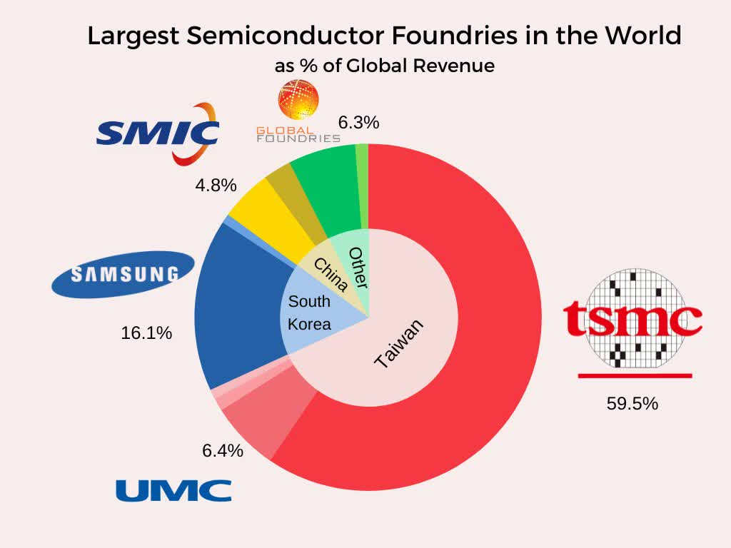
Taiwan has the largest semiconductor production in the world, that’s why we are interested to explore its economic priorities
We used market capitalization of TSMC, to explore how the largest semiconductor industry can impact its countries economy.

Slide 3
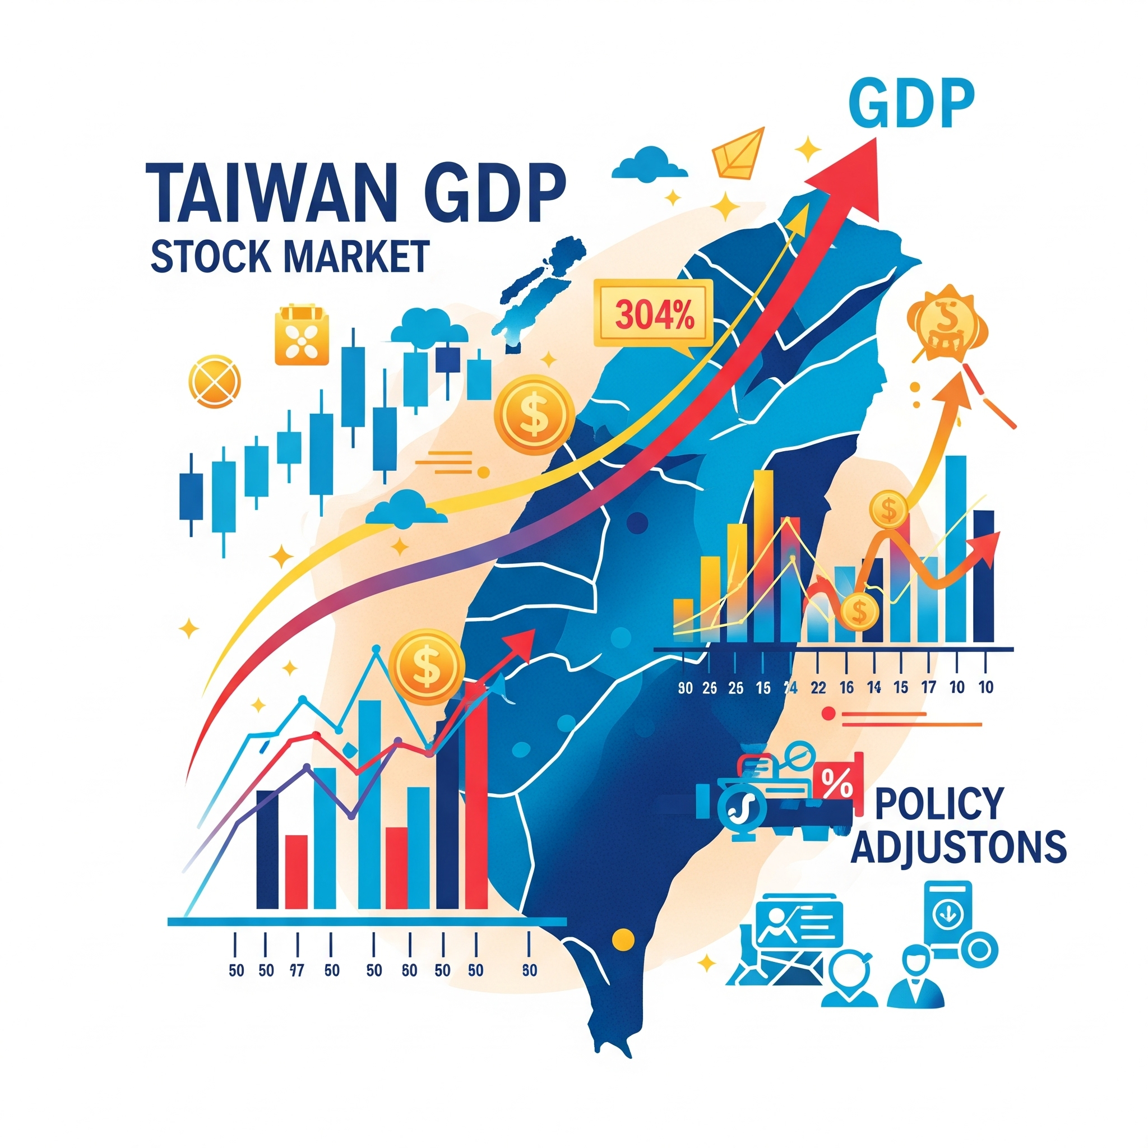
Taiwan GPD growth analysis
Taiwan GDP: Growth Dynamics
Taiwan GDP is a key indicator of economic performance.
Multiple models analyze Taiwan GDP growth dynamics.
Stock market movements lead to policy adjustments.
Long-run GDP relationships exist with market indicators.
Taiwan economy shows rapid adjustment to equilibrium.

Slide 4
VAR model features
TWD/USD Exchange Rate, US Interest Rate (%),US GDP Growth (%), S&P 500 Index (LAG 0)
Taiwan_GDP, TAIEX Index, Taiwan Interest Rate (%), Taiwan-China Trade (USD Billions) (LAG 1)
Taiwan_GDP, TAIEX Index, Taiwan Interest Rate (%) (LAG 2)
Endogenous: Taiwan Interest Rate (%), TAIEX Index_diff, Taiwan_GDP_in_billions_usd_diff

Slide 5
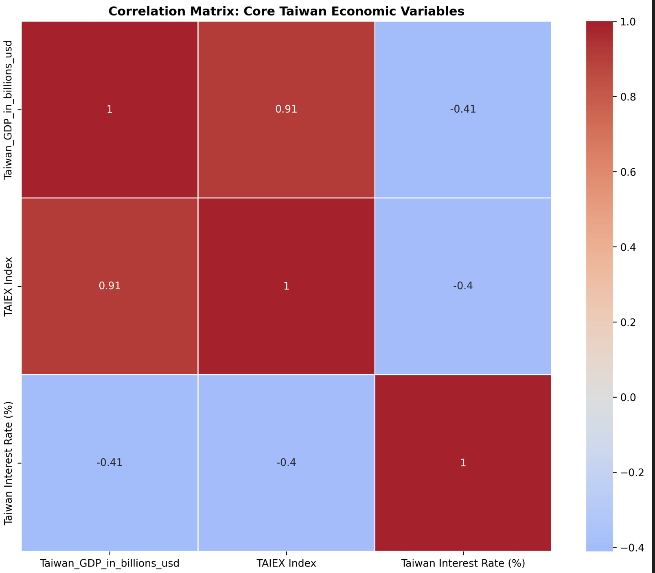

Slide 6
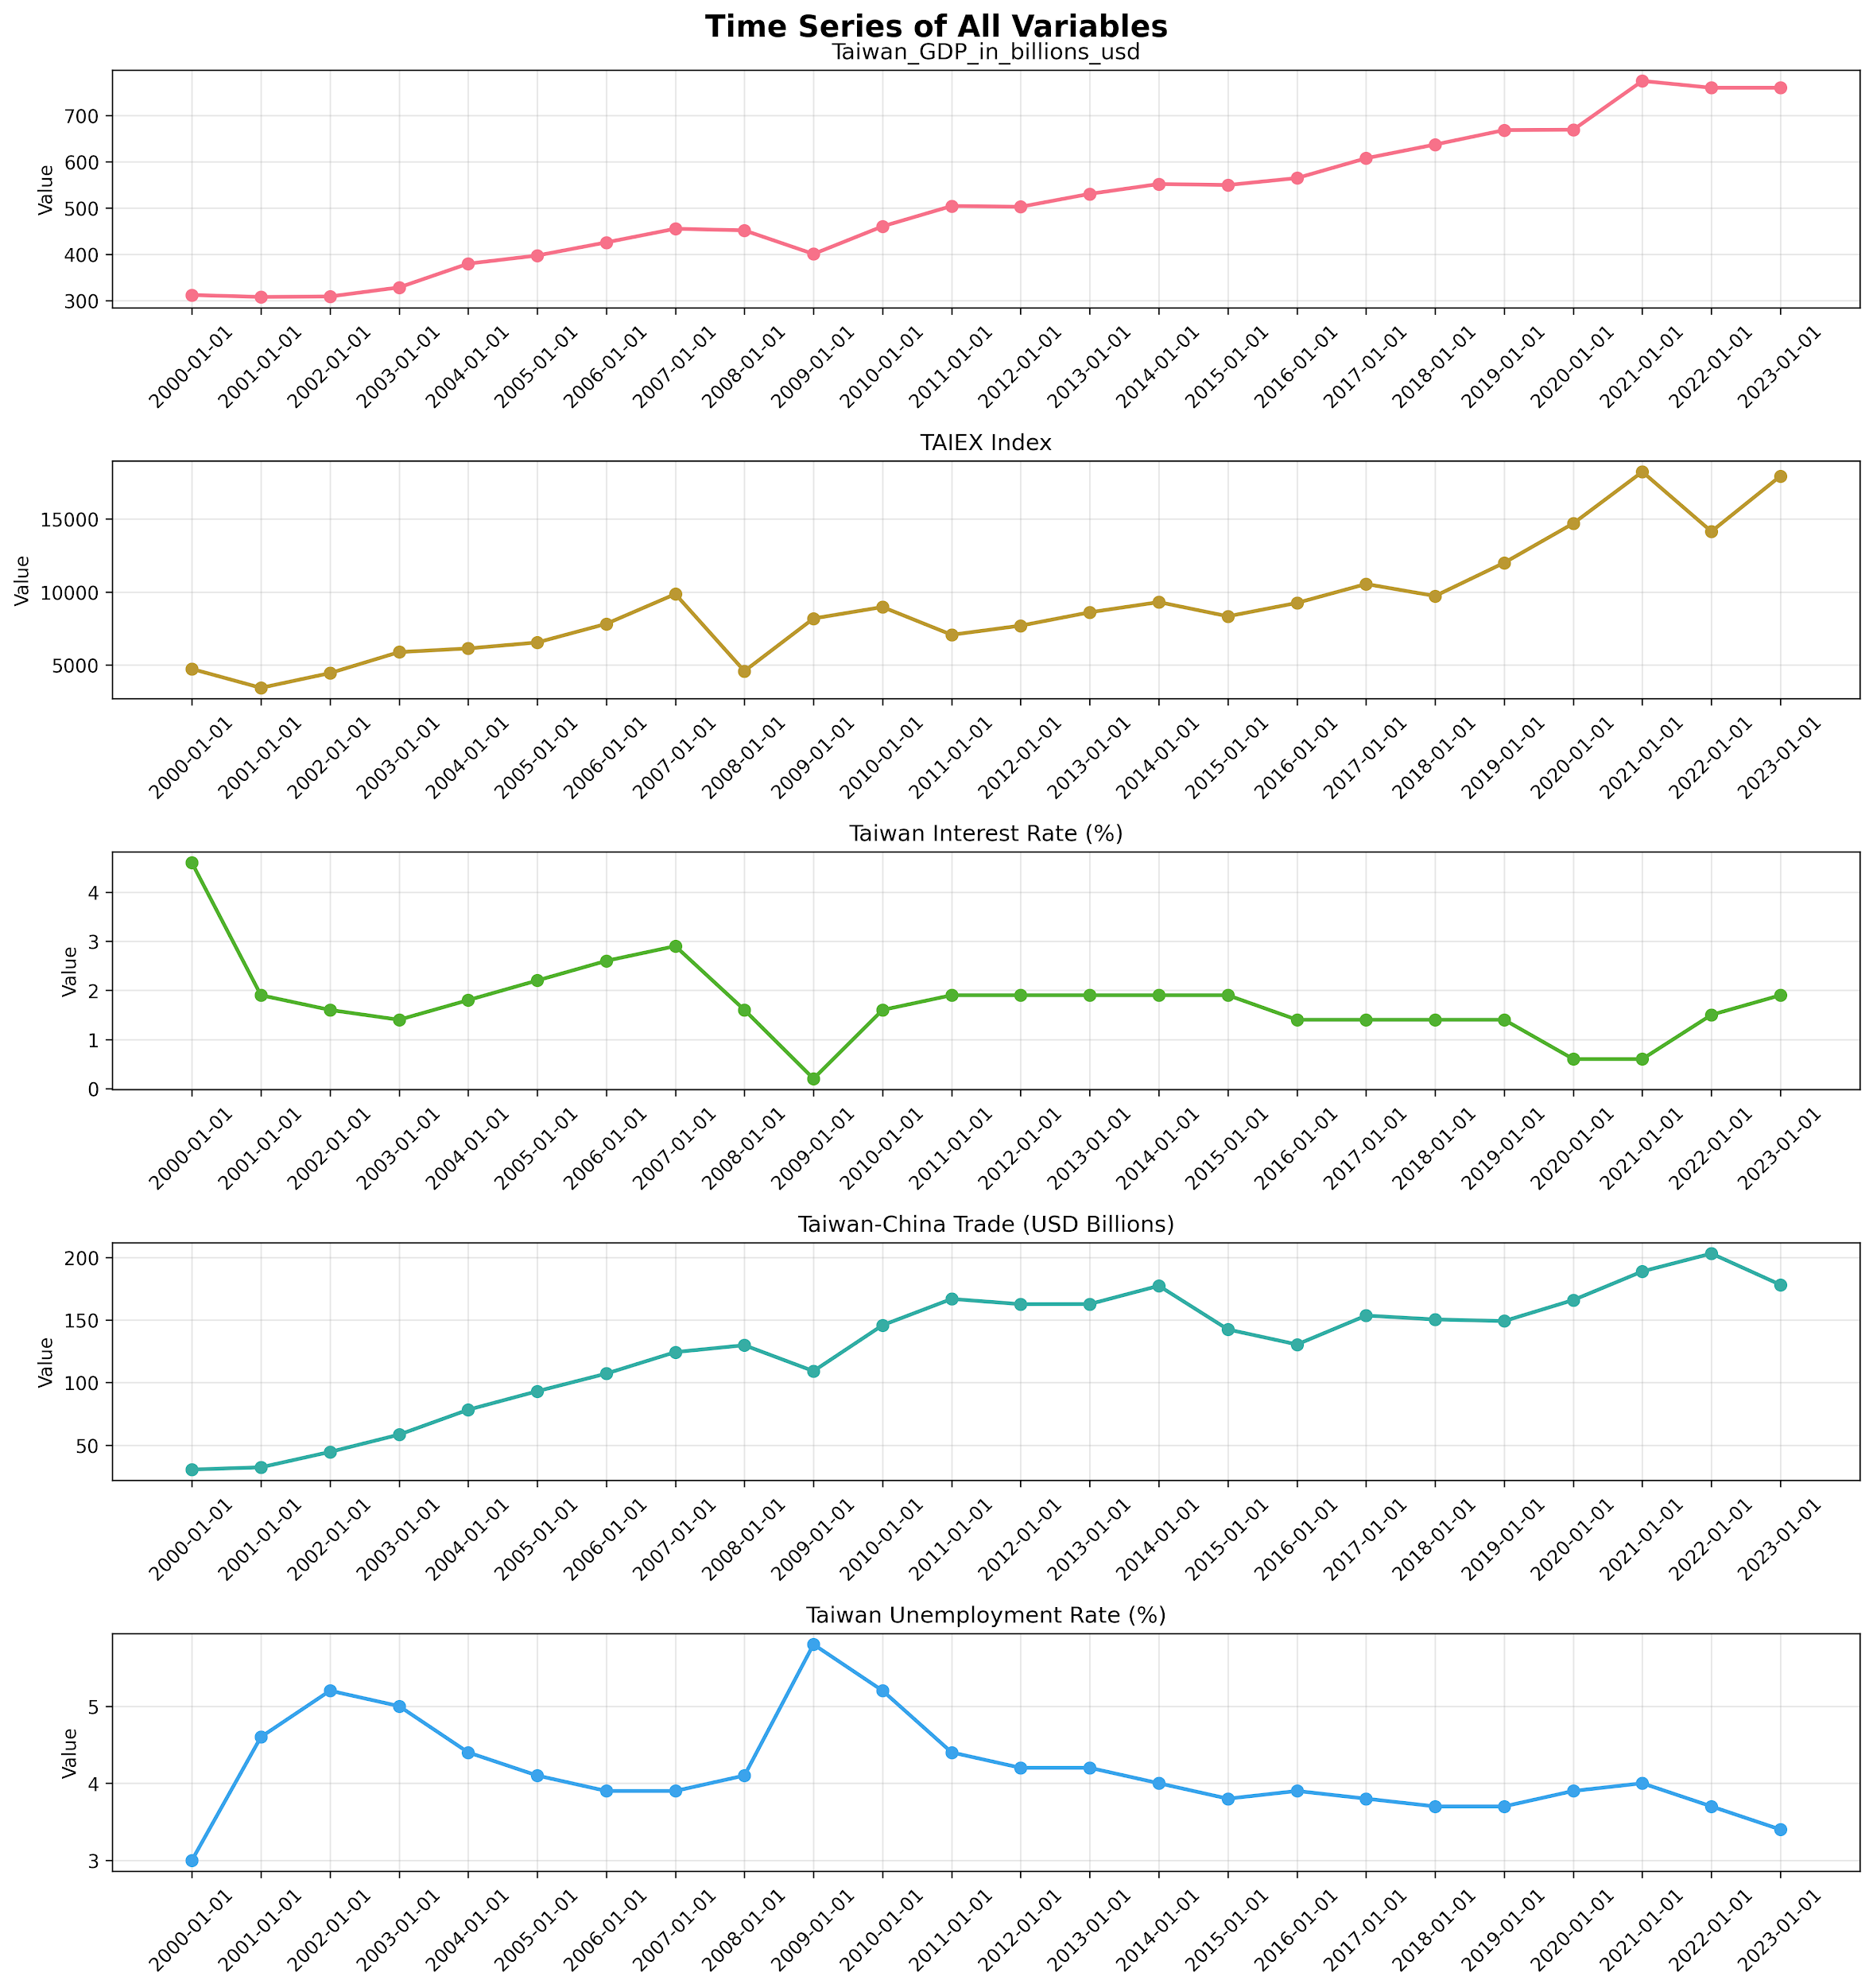
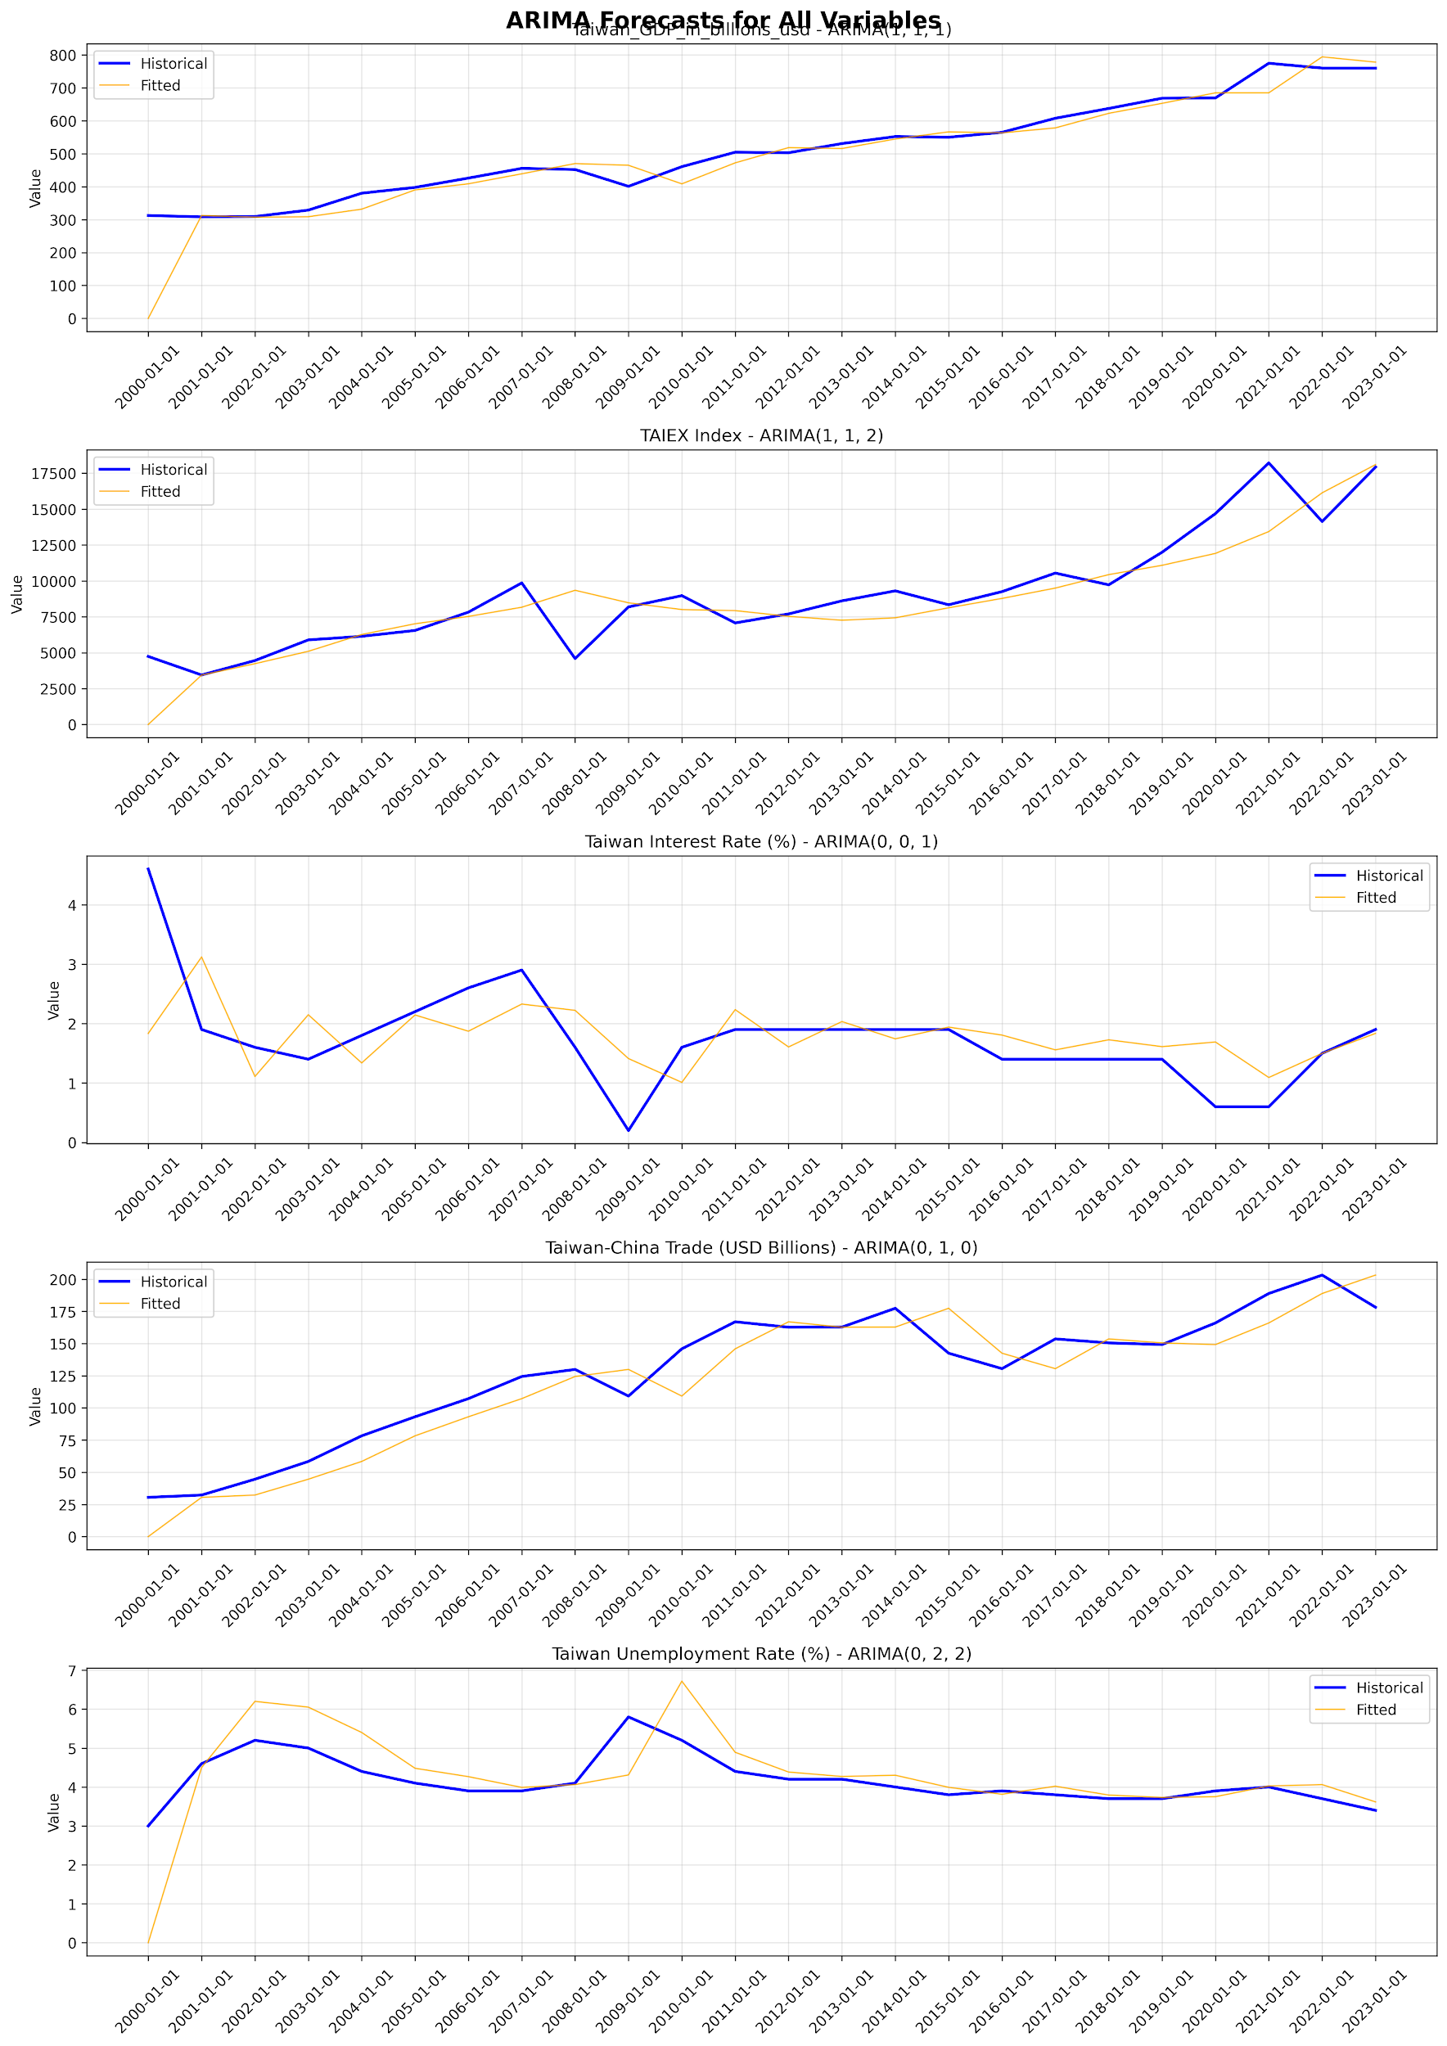

Slide 7
Taiwan_GDP_in_billions
Variable | Coefficient | Std. Error | t-Stat | Prob.
const | 112.202279 | 80.888053 | 1.387 | 0.165
Taiwan-China Trade (USD Billions)_diff | 0.453592 | 0.253504 | 1.789 | 0.074
US GDP Growth (%) | 8.090908 | 1.704632 | 4.746 | 0.000
S&P 500 Index_diff | 0.025774 | 0.010437 | 2.469 | 0.014
TWD/USD Exchange Rate | -3.751386 | 2.635972 | -1.423 | 0.155
US Interest Rate (%) | 0.459606 | 2.213452 | 0.208 | 0.836
L1.Taiwan_GDP_in_billions_usd_diff | -0.369660 | 0.164722 | -2.244 | 0.025
L1.TAIEX Index_diff | 0.004634 | 0.002275 | 2.036 | 0.042
L1.Taiwan Interest Rate (%) | 7.316885 | 5.465179 | 1.339 | 0.181
L2.Taiwan_GDP_in_billions_usd_diff | -0.264266 | 0.149162 | -1.772 | 0.076
L2.TAIEX Index_diff | 0.002614 | 0.002198 | 1.189 | 0.234
L2.Taiwan Interest Rate (%) | -0.583611 | 6.275426 | -0.093 | 0.926

Slide 8
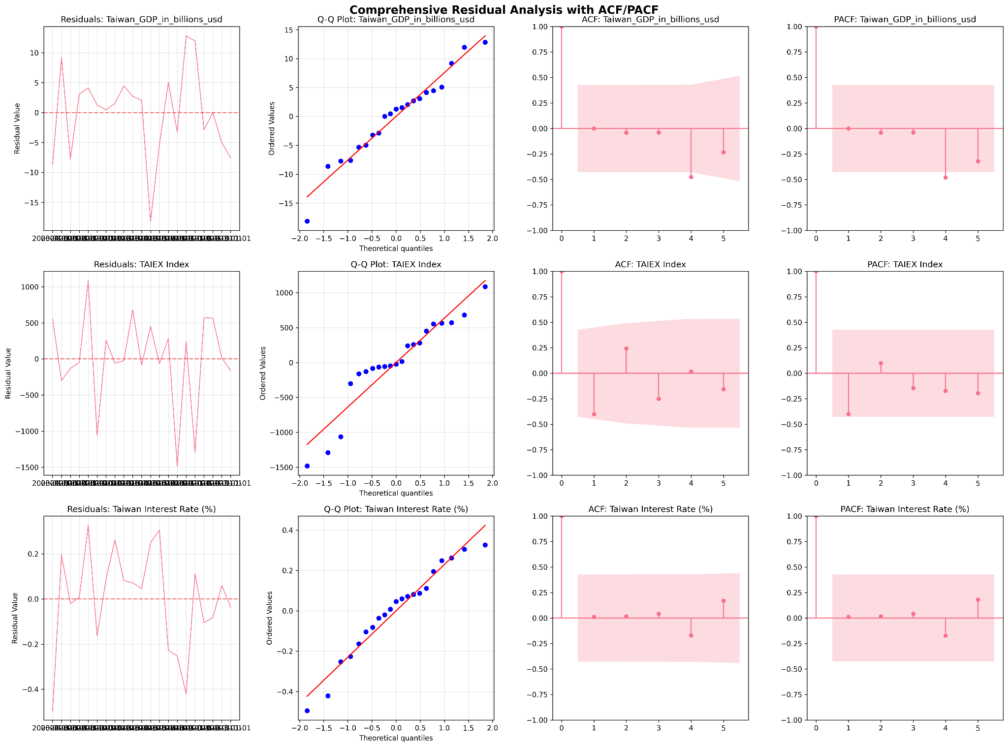
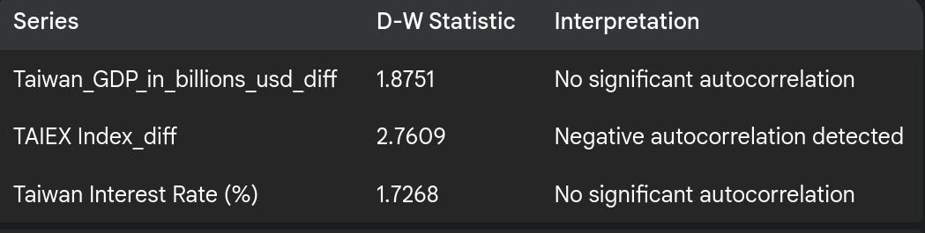
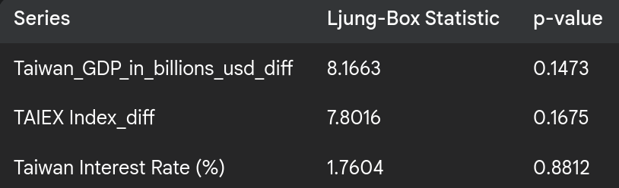

Slide 9
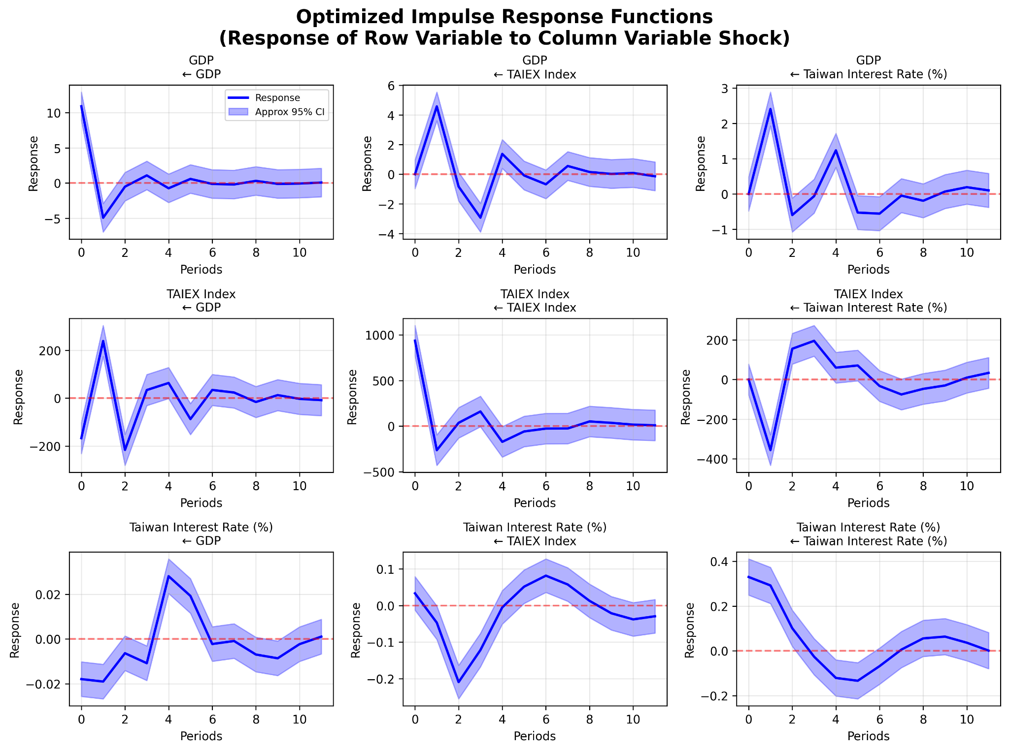

Slide 10
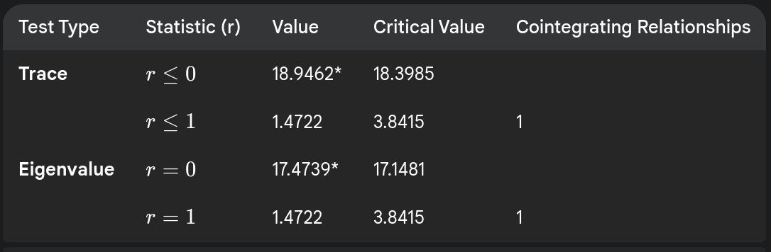
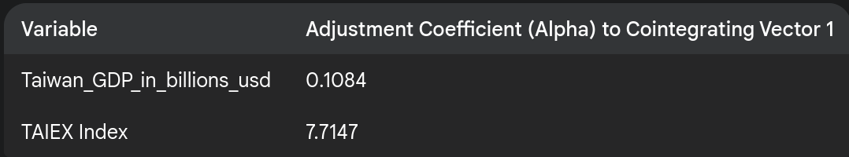
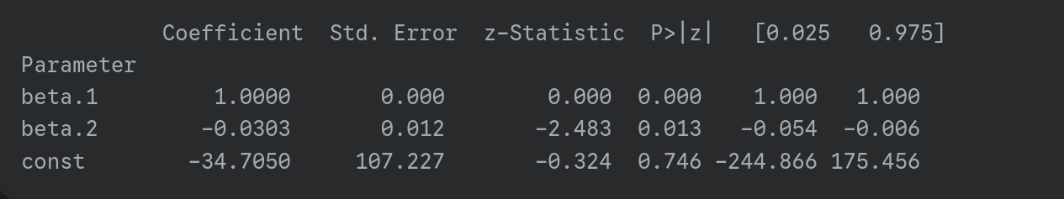
VECM

Slide 11
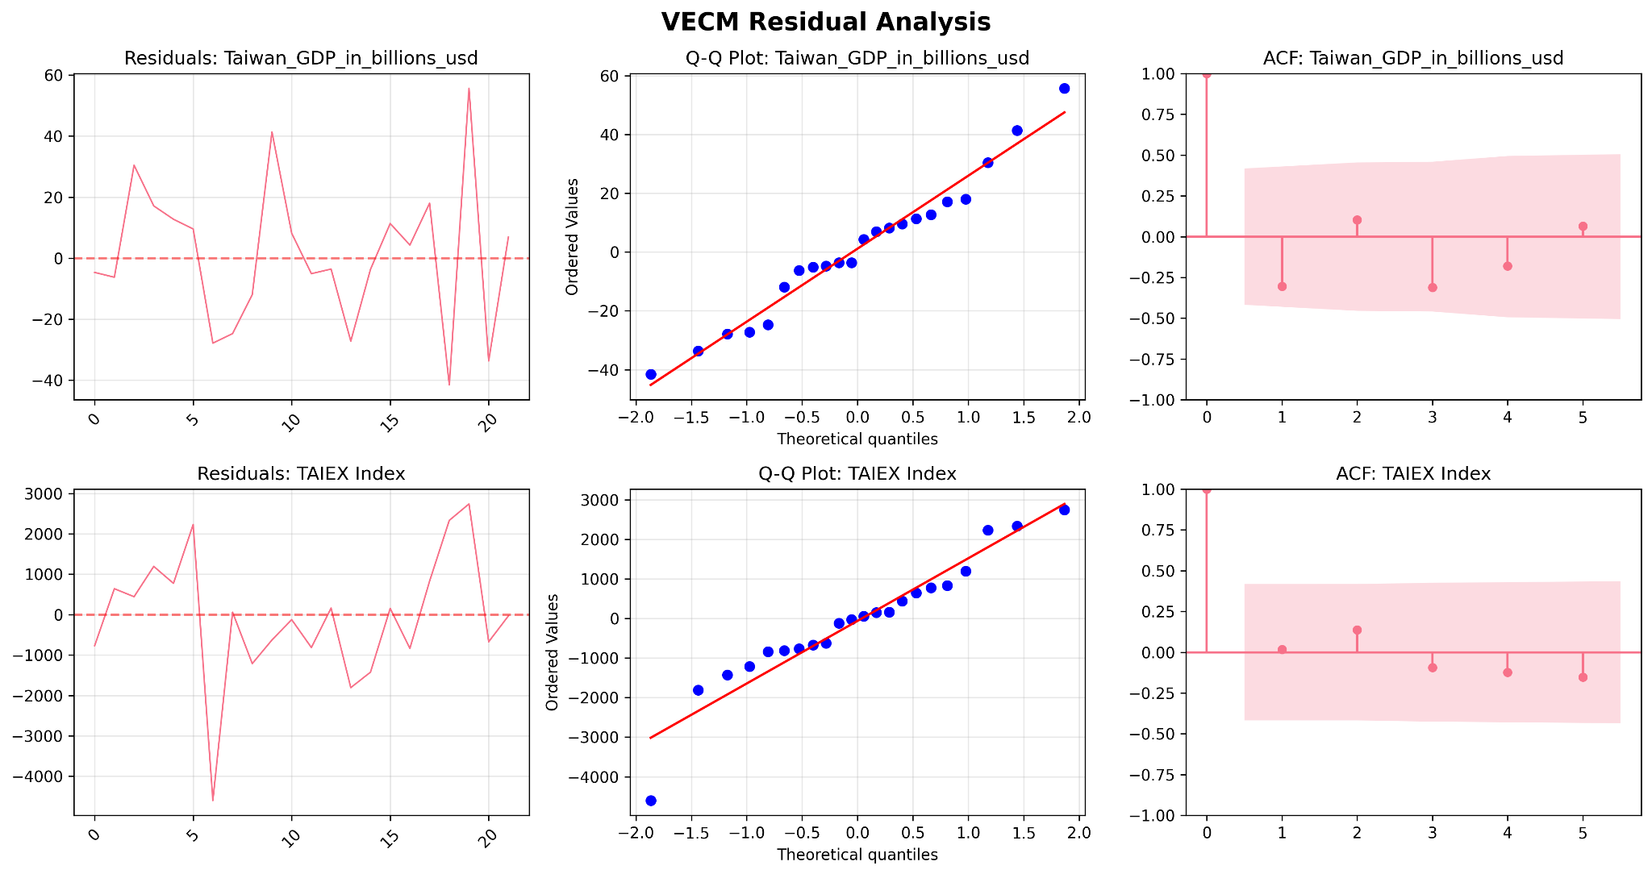

Slide 12
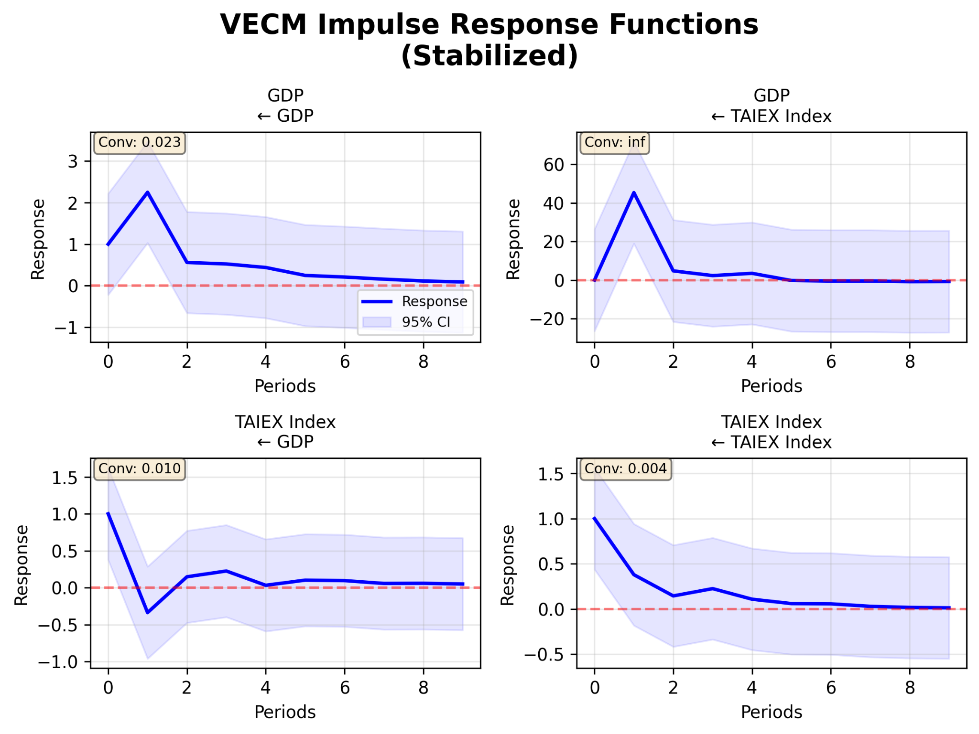

Slide 13
